Slide 1

Product Name:
SwapSquad
#FullStackFuture
© NIIT-StackRoute 2020-2021

Slide 2
Abstract Problem
Everybody possesses things that they no longer use. For example, say clothes, accessories, games, books, and so on. What you do with them?
Instead of throwing them away, any user would like to exchange them for some other items they need.This is referred to as barter trading.
The problem to solve is how we put up a platform to discover items we want and list items we want to share and start barter trading at free of cost.

Slide 3
Alternative Domains :

Slide 4
Pain Points
Communication problem : bargain
Needed person didn’t get it.
Right value for the product
Improper evaluation of the products: Like person has knowledge on that product so that they can check the right product
Not much beneficial for larger value of products
No match found : what somebody wants
Difference in the value of the products exchanged
Lack of double coincidence of wants
Indivisibility of Goods
Lack of Store of Value
Inconvenience in Lending and Borrowing
Inconvenience in Government Receipts and Payments
Lack of standards of products
If the exchanged things are detected how can they return.
There is caste difference where high caste people cannot exchange the things
People facing problem in backward areas where only few members have the needy things.
Lack of information

Slide 5
Pain Points(conti …)
Due to network problem people can't communicate .
Everything you have to buy with money only.
If you have any thing is more amount the price of that things getting lower.
It is very difficult to store goods particularly perishable goods for a long period. They lose their value as time passes.
If someone need the things of low value but have the things of high value.
Transportation problem of the products.
Problem in getting the distance between the peoples to exchange the things.

Slide 6
Users do not have idea about buyers who are available in their location and interested to exchanges their product , so it is waste of time for seller to find suitable buyer of their product.
So this product acts like a platform where sellers can register their products and buyers can choose suitable products of their choice by using chat features and payment service.
Core Problem
Notes:
Write all core problems here

Slide 7
User Experience (What can constitute bad experience? Why won’t a user visit again? (Non-Technical)
Desired Product does not matches.
Lack of Information about products.
Lack of proper description of the product
You provide useless, irrelevant content to your users.
Lack of availability of products.
Not happy with the previous exchanges.
No replacement of product .
Shipping Problem.
When product doesn’t match upto the expectation of customers
Customer service related issues
Users are not trustworthy.

Slide 8
User Experience (What can constitute bad experience? Why won’t a user visit again? (Technical)
Slow -loading Sites.
Lack of engagement.
Lack of Contact information.
To much , less images or bad image quality.
Payment information ,and payment gateway not work properly.
Not user friendly site due to lot of extra features.
Your website has a complicated navigation.
Pop-ups with the Close button.
Lack of Different category wise product search.
Layout issues with website pages.
Poor or Underrated Website Design.
Overall, how satisfied were you with your site Search experience is not given.

Slide 9
Event Storming
Books | Chair | Bike | Bicycle | Geysers | Microwave | Shoe Racks | Bean Bags
Clothes | Table | Stove | Speakers | Vacuum Cleaners | OTGs | Bookshelves | Aquarium Tank
Mobile | Refrigerator | Bag | Utensile | Water Purifiers | Beds | Dressing Tables | Watches
Laptop | Shoes | Watch | Lighting | Chimenyes | Sofas | Swings | Belts
Fan | Television | Milton Bottles | Battery | Mixer | Mattresses | Kids Seating | Wallets
Clock | Extension Board | Cooler | Dinner Sets | Toys | Office Chairs | Home Temple | Lens
Air conditioner | Headphone | Bags | Home Decor Range | Washing machine | Wardrobes | Benches | Sunglasses
Grinder | Speakers | Earbuds | Bedsheets | Inverter | Recliners | TV Mounts | Sportswear

Slide 10
Event Storming (Contd.)
Sports Gear | Suitcase | Power Banks | Pen | Silver | Wall Stickers | Medicines
Smart Watches | Rucksacks | Data Storage | Pencils | Step Ladder | Wall Stickers | Noodles
Supplements | HandBags | Gaming Accessories | Mobile Charger | Grass Mats | Painting | Speaker
Fitness Equipments | Cameras | Bath Fitting | Laptop Charger | Water Pumps | Hair Oil | Thermometer
Handmade Handlooms | Mobile Accessories | Screwdriver Sets | Battery Table Fan | Extension Cords | Trimmer | Earbuds
Guitars | Speakers | Mop Sets | Furniture | Dispensers | Photo Frames | Router
Keyboards | Home Audio | Coppers & Knives | Gold | Dogs | Wall Shelves | Hand Tools

Slide 11
I Wish (Benchmark Systems)
For OLX people buy or sell the product, In our Application they can exchange the product .money transaction isn’t involved .
For each and every transaction they get some coins as the reward.
Images should be properly taken of the product.
We make it necessary that people have to upload the short video of working product.
We make sure not to promote fake ads.
We try to make sure not to delay in response of both seller and buyer.

Slide 12
I Like (Benchmark Systems) URL (Website) :
Language change feature : https://www.olx.in/en-in (olx)
Load more products like without going to another age : https://www.olx.in/en-in (olx)
Create the fields which is not mentioned in product list : https://www.olx.in/en-in/post/attributes1 (olx)
Good design to attract customers(https://www.flipkart.com)
Catalogs to display your products(https://www.flipkart.com)

Slide 13
Identify the Stakeholder of the Product (Persona)
Below or average income people.
People living in town areas.
People of small business.
People having good network connection in their area.
People with basic knowledge on online shopping.
Those person whose job is transferable every two or three year.
Students.
Homewakers.

Slide 14
Financial Model
Notes:
Generating Revenue ways:

Slide 15
High-level Features
1. Users should be able to register in our platform 2. User should be able to login using JWT authentication and OAuth
3. Communication between users through chatroom.
4.Email notification.
5.Rating feature.
6.Images of Products.
7.Filtration.
8.Distance between customers
9.Share feature

Slide 16
Microservices Decomposition
Microservices | Database
User authentication management service Otp sevice | Mysql [Abhay]
User service | Mysql [Prince]
Product Details | Mysql [Rituraj]
Recommendation | Mysql
Chat Feature | Mysql
Email Notification service for sending the products | Mysql
Transaction Details | Mysql
Payment Services | Mysql

Slide 17
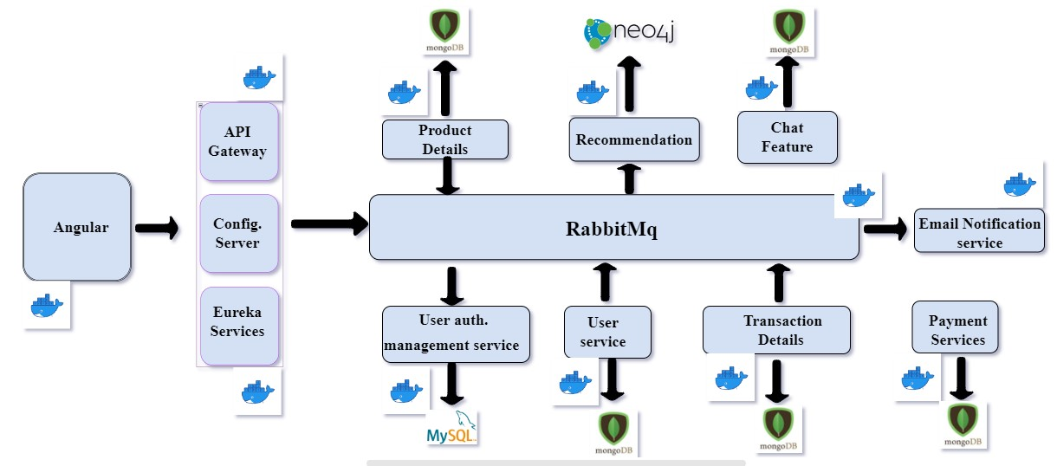
Architecture Diagram

Slide 18
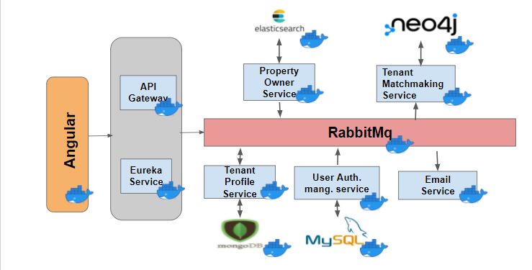
Sample Architecture Diagram

Slide 19
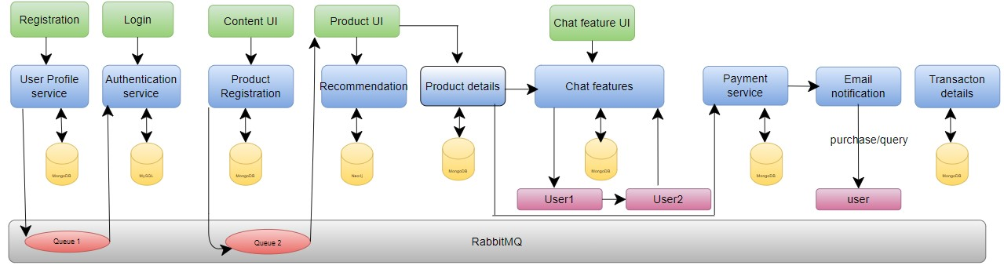
Data flow

Slide 20
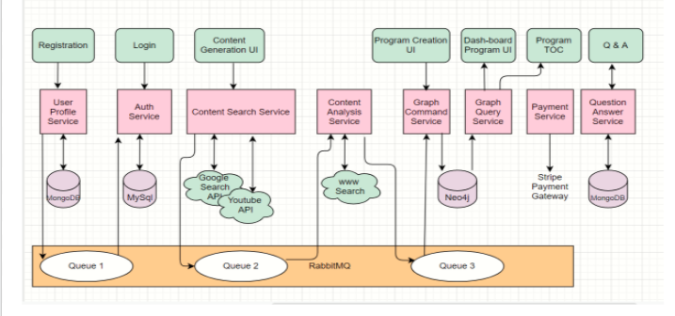
Sample Data flow

Slide 21
Data Model
1-login-service: Class User{ “userEmail” : String, “userFullName” : String, “userPassword”: String, “role” : Set<Role> } Class Role { “roleName”: String, “roleDescription”: String } | 2-User Registration Service:- Class UserRegistration{ “FirstName”:String, “LastName”:String, “Age”:int, “Gender”:String, “Mobile No.”:Longint, “Email”:string, “Password”:string “CPassword”:String Class Address{ “Location”:string, “Landmark”:string, “City”:string, “District”:string, “country”:string, “pincode”:int, } } | 4-Product Details:- Class Product{ “Product Id”:Integer, “Product owner email”:string, “Name”:String, “Image”:list<byte>, “Purchase Date”:date, ⇒(pdatepost) “category”:String, “Date of post”:date, => (pdate) “Product Location”: “Product Status”:enum(available, Not available), “Mode of exchange”:enum(Bartering, Coins), “Price of product in coins”:Double, “Product list for exchange”:list<String>, “Description”:String }
2-email-service:- Class EmailRequest{ “subject”:String, “message”: String, “to”:String, } Class Verify { “senderEmail”:String, “sendedOtp”:int }

Slide 22
Data Model
5-Transaction Details :- Class Transaction{ “Transaction Id”: Longint, “Email buyer”: String, “Email Seller”: String, “Product Name”:string “Date of Transaction”:Date, “Transaction Method”:enum(Bartering, Coins), “Price of product in coins”:Double, “Exchange product list”:list<String> “history details”:string: } | 6-Recommendation:- Class recommendation{ “Product Id”:int, “Product owner Email”:string, “city”:string, “State”:string, “Product Category”:string, “Mobile No.”:Longint, “Product name”:String, “Product image”:byte } | 7-Email Notification service :- Class Notification{ “emailBuyer”: String, “Email Seller”: String, “Product Id”:int, “Product name”:String, “Transaction Number”: Longint, “Date of Transaction”:Date, “Transaction Method”:String }

Slide 23
Data Model
3-Chat feature:- Class Chat{ chatId:int, “ownerEmail”: String, “buyerEmail”:String, “List<Message>”{ “senderEmail”:string, “Time”:time, “replyMessage”:string } | 6-Recommendation:- Class recommendation{ “Product Id”:int, “Product owner Email”:string, “city”:string, “State”:string, “Product Category”:string, “Mobile No.”:Longint, “Product name”:String, “Product image”:byte } | 7-Email Notification service :- Class Notification{ “emailBuyer”: String, “Email Seller”: String, “Product Id”:int, “Product name”:String, “Transaction Number”: Longint, “Date of Transaction”:Date, “Transaction Method”:String }

Slide 24
Product names
BarterMate
BarterKart
EasyBarter
Barter
Exchange Product
QuickBarter
EasyExchange
Easychange
Give&Take -
Trade on Trade
Swapkart
eBarterCLub
SwapSquad -
ExchangeBucket
Swapily -
Barggain
Swapza
BarterSpot
FreeSwap

Slide 25
Thank You
#FullStackFuture
© NIIT-StackRoute 2020-2021
Notes:
Thank you

